Slide 1
Pipe joints

Slide 2
Pipes are made of cast-iron, steel, wrought-iron, brass, copper, lead or concrete or plastic.
They are used for carrying fluids — water, steam, gas, oil etc. from one place to another.
Various forms of joints are used for connecting them, depending upon the material of the pipes and the purpose for which they are used.
Pipes are specified by their internal diameter.
The fluid-circuit consists of the pipes, the valves, the pumps and the reservoirs.

Slide 3
Pipes are manufactured in small lengths of 2 to 6 meters.
These small pieces of pipes are then joined together after placing them
in position, to make one continuous length of the pipeline.

Slide 4
PIPE FITTINGS
Pipe fittings are those fittings that may be attached to pipes in order to:
o Change the direction of flow in the pipe.
o Connect a branch with a main water supply pipe.
o Connect two or more pipes of different sizes.
o Close the pipe ends

Slide 5
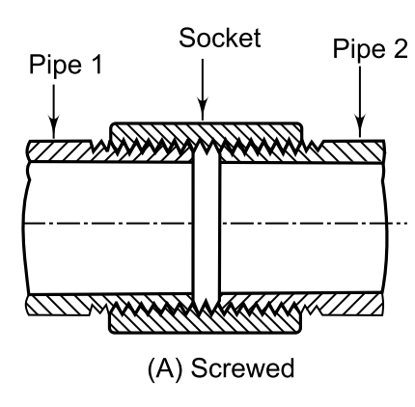

Slide 6
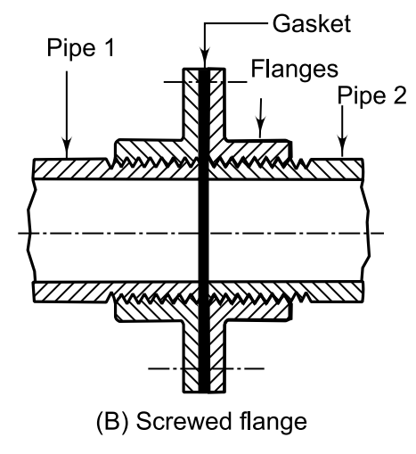

Slide 7
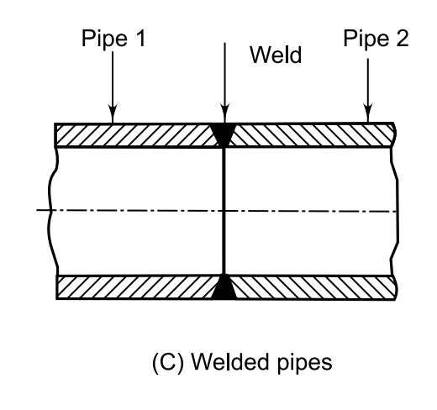

Slide 8
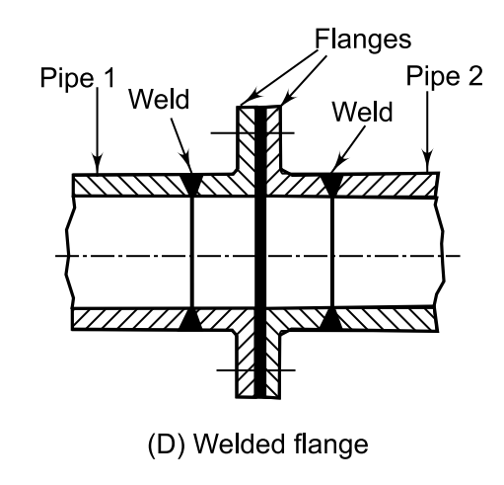

Slide 9
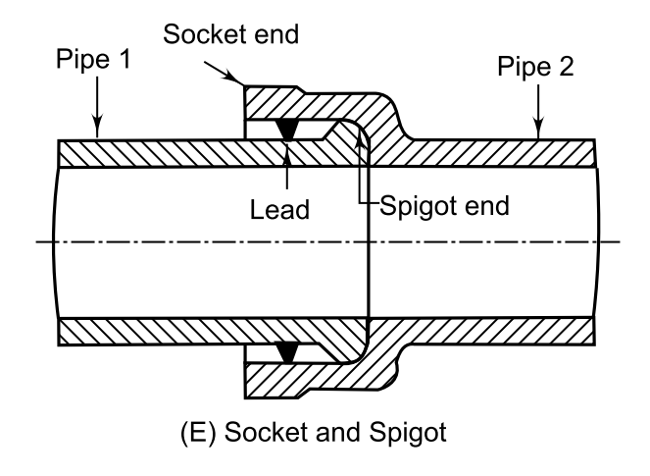

Slide 10
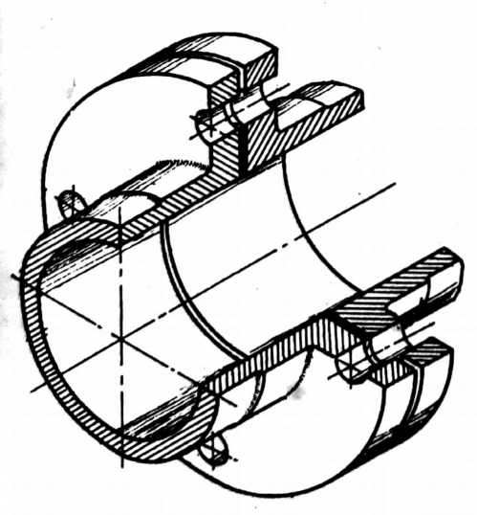
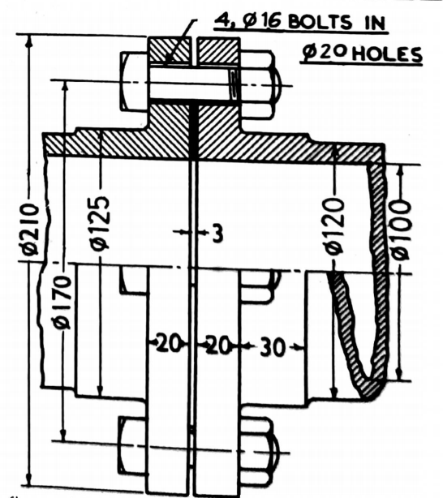
Cast-iron pipes - Cast-iron flanged joint

Slide 11
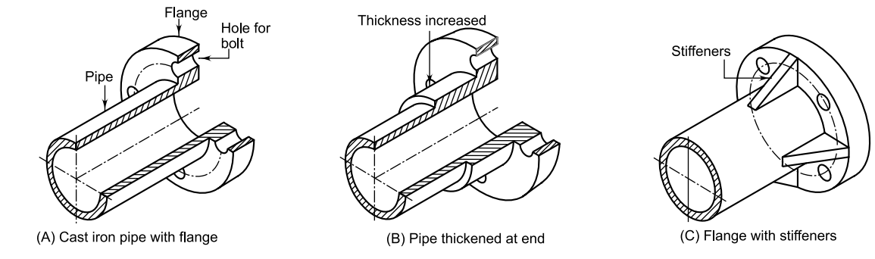
End of caste and pipes

Slide 12
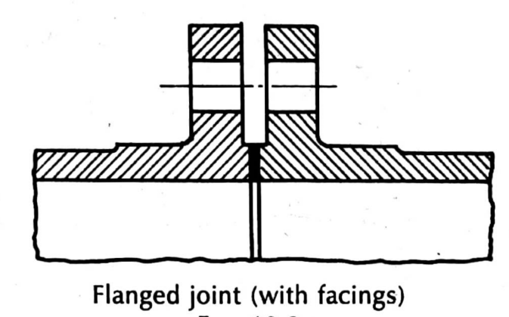
Flanges are cast at the ends integral with the pipes.
A packing-ring or gasket of soft material such as India-rubber, canvas etc., coated with red lead, is placed between the faces of the two flanges, which are joined together by means of bolts.
Sometimes, flanges are provided with facings of about 3 mmto 5 mm thickness, between which the packing ring is placed.

Slide 13
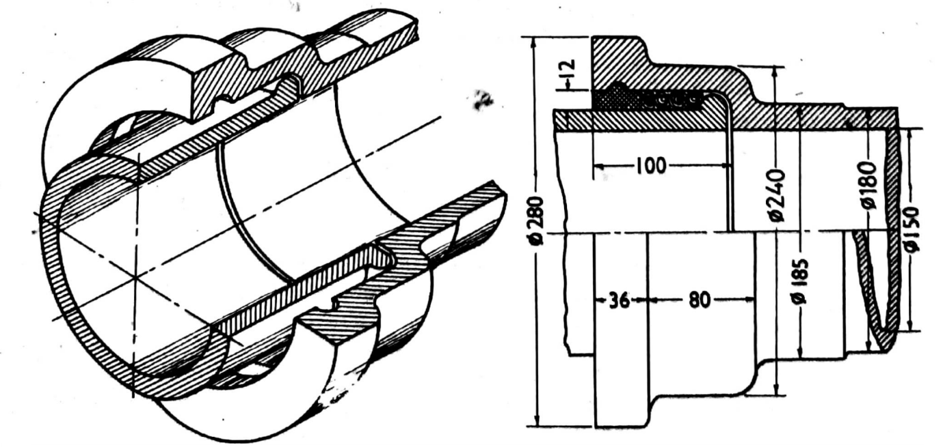
Socket and spigot joint

Slide 14
Cast-iron pipes which are to be embedded in the ground are
usually connected by this joint.
The joint being slightly flexible, adopts itself to small changes in level due to settlement of earth.
The spigot-end of one pipe enters the socket-end of the other. The joint is
made by filling-up the space between the two, partly by several turns of
jute yarn and the remaining by pouring molten lead. The lead when
solidified, is caulked-in tightly with a hammer and a chisel.

Slide 15
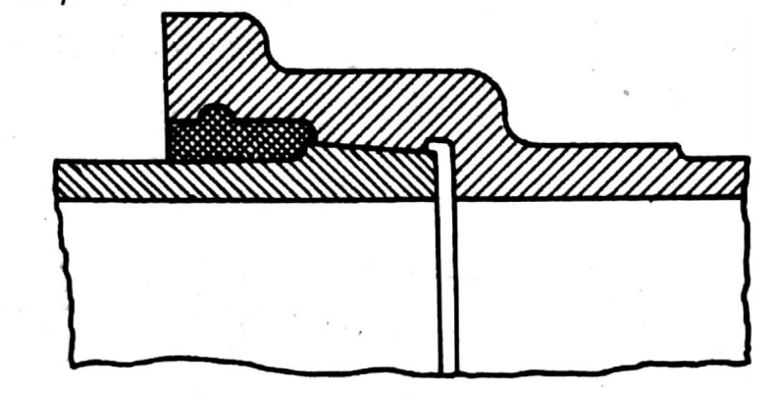

In the form of lead joint shown in fig, taper facings are provided
on the inside of the socket and on the outside of the spigot. The facings
are accurately machined to fit properly, and are smeared with red lead
before forcing the pipes together. This joint is suitable for pipes in a straight line only.

Slide 16
Hydraulic joint
This form of joint is used where fluids under high pressures varying
from 60 to 90 kg per sq cm are to be conveyed. The flanges (of pipes) are
cast, generally oval in shape. A small circular spigot, provided in the
centre of one flange, enters and fits in an accurately machined socket
(having a recess) in the other flange. The joint is made with a V-shaped
gutta-percha ring inserted inside the recess. The flanges are connected
together by two large-size bolts. The top half of the side view in
fig. shows the view of the face of the right-hand flange.

Slide 17
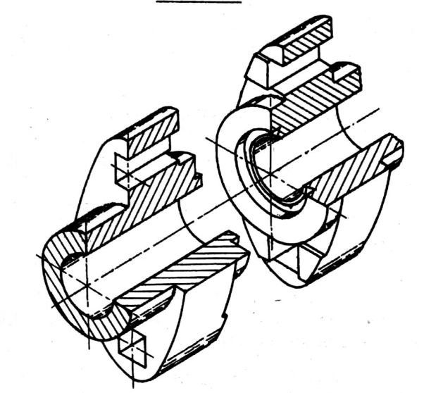
Hydraulic joint

Slide 18
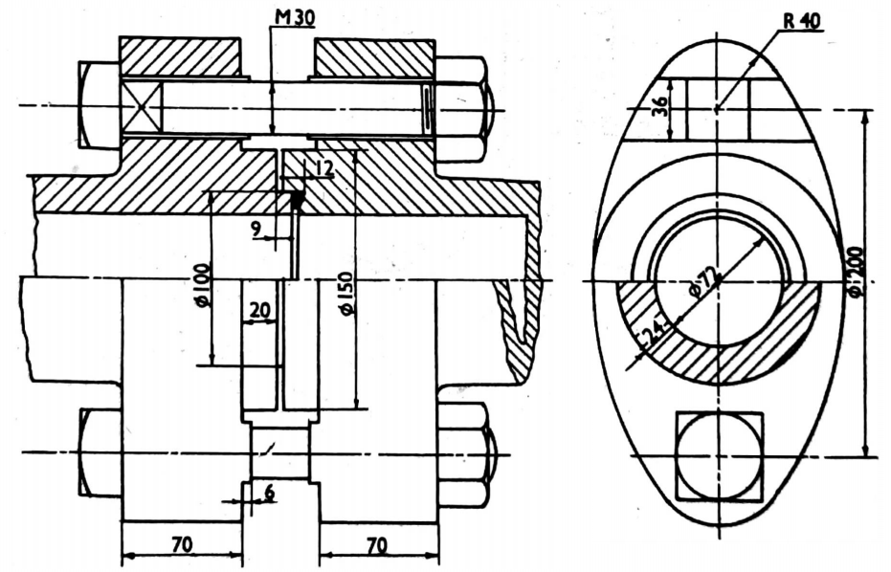

Slide 19
Wrought-iron and steel pipes
Wrought-iron pipes are generally butt-welded and are made in
comparatively smaller sizes, viz. from 12 mm to 100 mm internal diameters.
These pipes are mainly used for domestic purposes and are usually galvanized all over. Weldless or solid-drawn steel pipes have great strength and are used for carrying fluids under ordinary as well as high
pressures.
These pipes have largely superceded cast-iron pipes where high pressures are to be considered. These pipes are joined with their
axes in alignment, by means of a socket or a coupler.

Slide 20
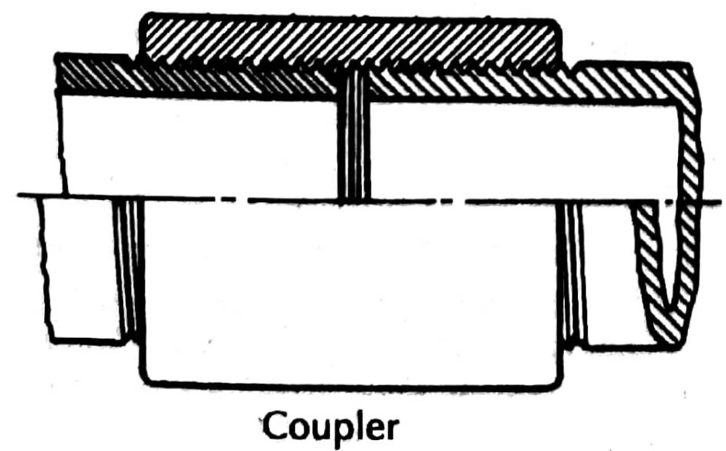
The socket is threaded on the inside and screwed-on half-way on the
threaded end of one pipe. The end of the other pipe is then screwed
into the socket in the remaining half. To prevent leakage through the
joint, a few strands of jute or hemp coated with red lead are wound round the bottom of the thread on each pipe-end.

Slide 21
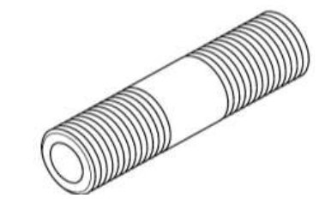
Nipple
A nipple, which is threaded on the outside, is also sometimes used. It is screwed inside the internally threaded ends of the two pipes. In this case, the passage of the fluid is partially choked on account of the smaller inside diameter of the nipple.

Slide 22
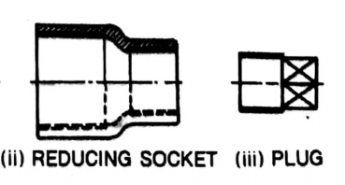
Pipes of different diameters are joined by the use of reducing sockets. A pipe can be closed at the end with a plug.

Slide 23
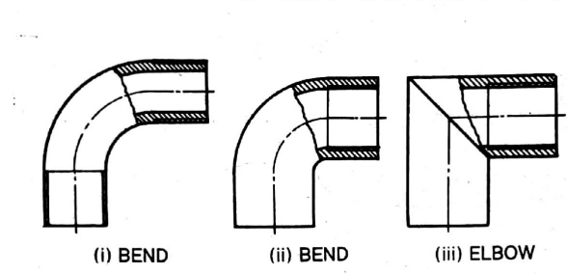
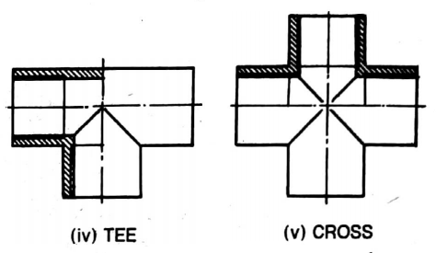
Pipes are connected or branched-off at right angles by means of fittings known as bends and elbows or tees and crosses

Slide 24
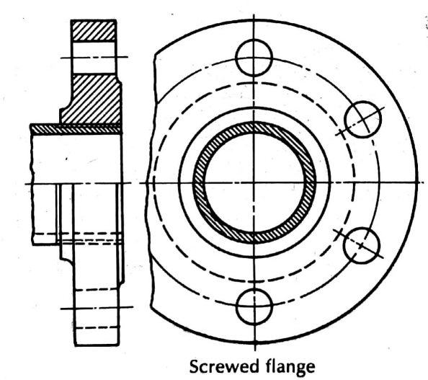
Pipes of large sizes are joined together by means of loose, cast-iron flanges screwed on the ends of the pipes and then bolted together. Rings made of asbestos or soft copper are placed between the raised facings.

Slide 25
Copper pipes
These are either solid-drawn or made from sheet copper with the
longitudinal joint brazed or welded. Separate flanges made of brass or
gun-metal are attached to the pipe-ends by brazing. In case of large-size pipes, the flanges are riveted to the pipe-ends before brazing. Copper pipes can be easily bent or coiled.

Slide 26
Union joint
It is used for pipes of small sizes. The nut A which is threaded
on its outside also, is screwed on the end of one pipe. Another nut B is
screwed on the end of the other pipe. The two nuts, together with pipes,
are drawn together by a coupler nut C. A packing ring, inserted between
the ends of the two pipes, prevents leakage.

Slide 27
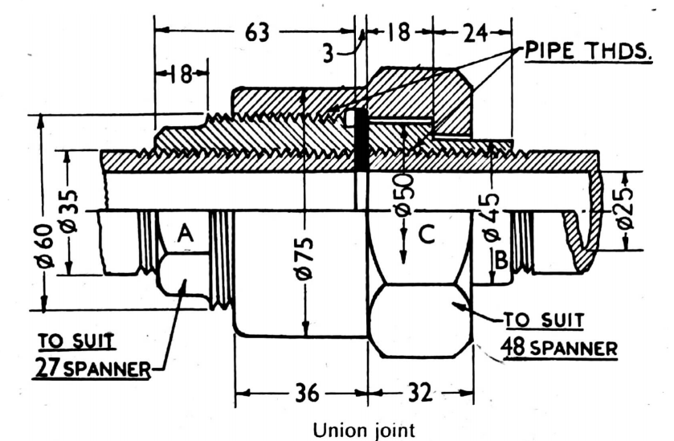

Slide 28
If there is a long pipe line having many screwed joints in series, it is not possible to open any single joint unless the whole line is disconnected. Use of a union joint is very convenient when a long pipe line is to be opened at any intermediate location. It consists of two sockets and a coupler nut.

Slide 29
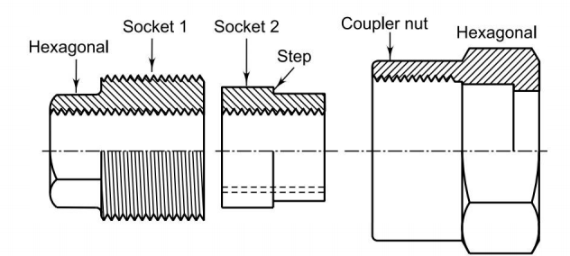

Slide 30
Socket 1 has internal threads and is screwed over threaded end of one pipe. The socket is hexagonal for some length so that it can be tightened with a spanner. Rest of the length has external threads on which the coupler nut is tightened.
Socket 2 also has internal threads to accommodate the pipe end and has a step on its outside surface.
Coupler nut is slipped over the second pipe before tightening socket 2. Then the coupler nut is tightened over socket 1 with a gasket in between the faces of sockets.

Slide 31
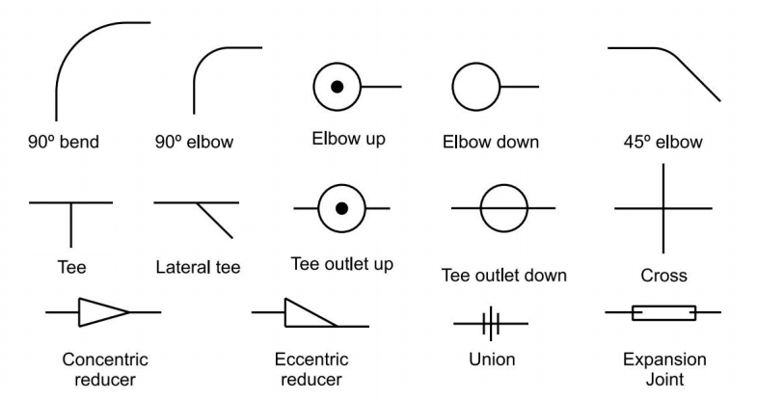
PIPING SYMBOLS- Fitting Symbols

Slide 32
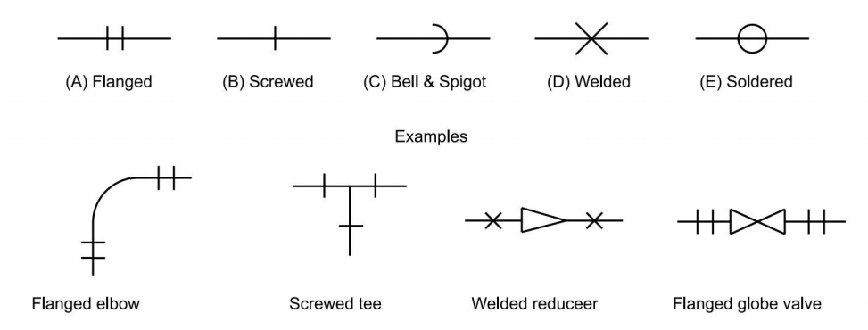
Joint Symbols

Slide 33
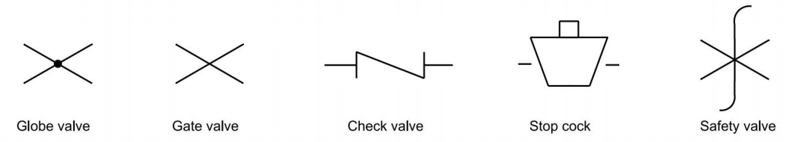
Valve Symbols

Slide 34
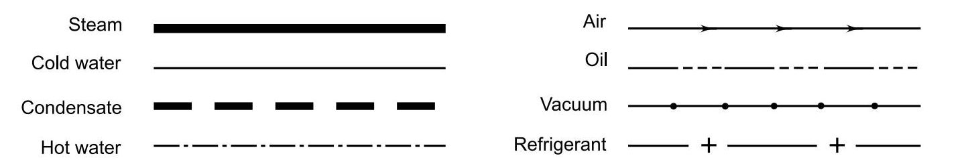
Fluid Symbols

Slide 35
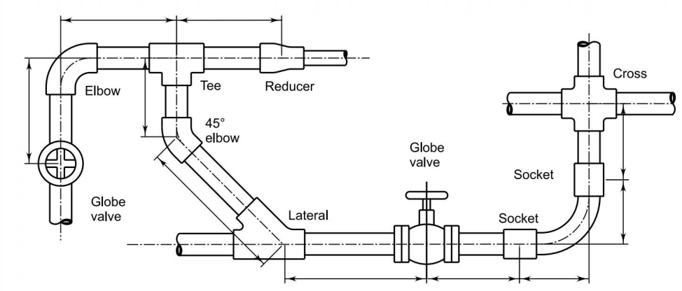
PIPING LAYOUTS - • Double line layout

Slide 36
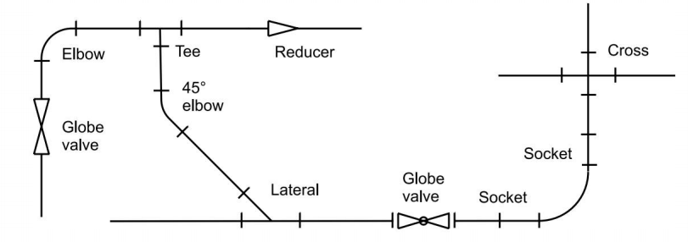
Single line layout

Slide 37
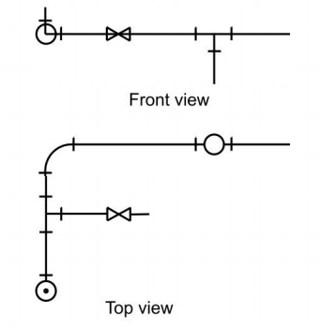
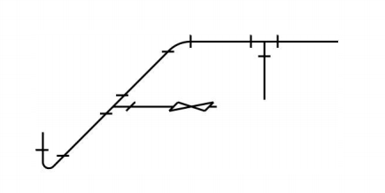
Orthographic views
Pictorial view

